Slide 1
THE WILL TO BELIEVE
WILLIAM JAMES

Slide 2
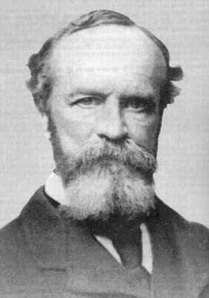

Slide 3
HYPOTHESIS = ANY STATEMENT
LIVE HYPOTHESIS (FOR YOU): A hypothesis that you could possibly believe.
DEAD HYPOTHESIS (FOR YOU): A hypothesis that you could not possibly believe.

Slide 4
OPTION: A DECISION BETWEEN TWO HYPOTHESIS
LIVING OPTION (FOR YOU): BOTH HYPOTHESES ARE LIVE (FOR YOU)
FORCED OPTION: A DECISION BETWEEN TWO HYPOTHESES THAT CANNOT BE AVOIDED.
MOMENTOUS OPTION (FOR YOU): A DECISION WHICH WILL MAKE AN IMPORTANT DIFFERENCE TO YOUR LIFE.

Slide 5
KEEP THESE DISTINCTION IN MIND WHILE WE CONSIDER:
PASCAL’S WAGER: AN ARGUMENT THAT YOU OUGHT TO MAKE A DECISION TO BELIEVE A THAT GOD EXISTS

Slide 6
NOTE ON EMENDATIONS
PASCAL ACTUALLY DISCUSSES WHETHER OR NOT ONE OUGHT TO BELIEVE IN THE GOD OF CHRISTIANITY. IN ACCORDANCE WITH OUR DECISION ABOUT THIS COURSE, WE ARE GOING TO GENERALIZE THE ARGUMENT SO THAT IT IS NOT SPECIFIC TO THAT RELIGION

Slide 7
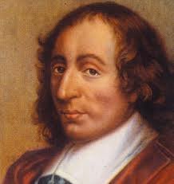
BLAISE PASCAL (1623 - 1662 )

Slide 8
BRIEF VERSION OF PASCAL’S WAGER
YOU MUST EITHER BELIEVE IN GOD OR NOT.
THE EVIDENCE IS EVENLY BALANCED: 50-50.

Slide 9
WHAT IF GOD EXISTS?
IF GOD EXISTS AND YOU BELIEVE, THEN YOU GAIN IMMORTALITY AND ETERNAL BLISS.
IF GOD EXISTS, AND YOU DON’T BELIEVE THEN YOU LOSE ETERNAL BLISS (AND PERHAPS GET ETERNAL SUFFERING).

Slide 10
WHAT IF GOD DOESN’T EXIST?
IF GOD DOESN’T EXIST AND YOU BELIEVE , YOU LOSE NOTHING.
(5) IF GOD DOESN’T EXIST AND YOU DON’T BELIEVE , THEN YOU LIVE YOU LIFE AS AN ATHEIST AND THEN: EXTINCTION!

Slide 11
CONCLUSION: YOU OUGHT TO BELIEVE THAT GOD EXISTS:
EITHER WAY, YOU COME OUT BETTER IF YOU BELIEVE THAT GOD EXISTS.
THEREFORE, YOU OUGHT TO BELIEVE THAT GOD EXISTS.

